Slide 1
VLSI DESIGN
Lecture 9
B.E (ECE) 5th semester

Slide 2
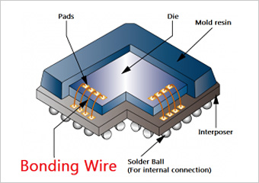
Metallization
Metallization is the process by which the components of IC's are interconnected by aluminium conductor. This process produces a thin-film metal layer that will serve as the required conductor pattern for the interconnection of the various components on the chip.

Slide 3
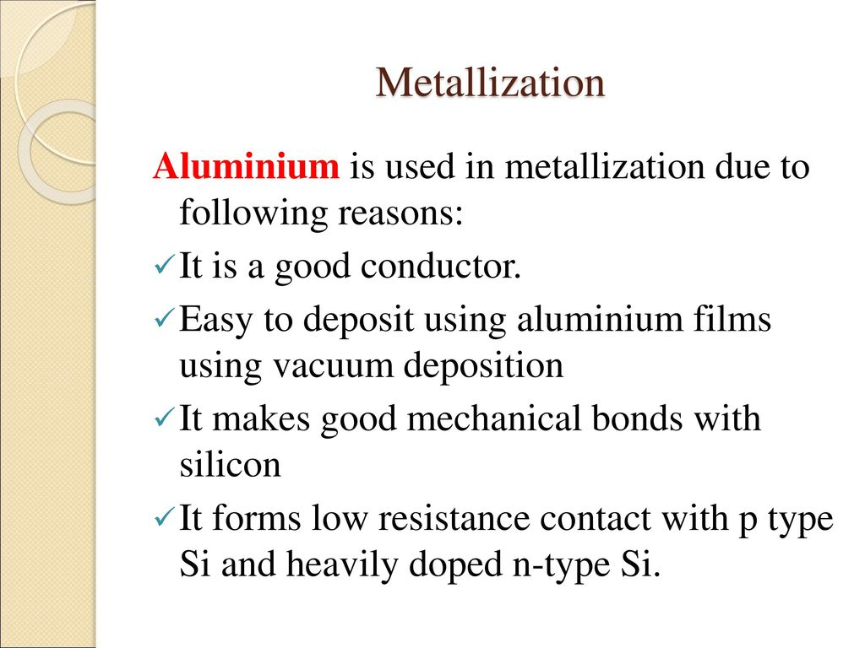

Slide 4
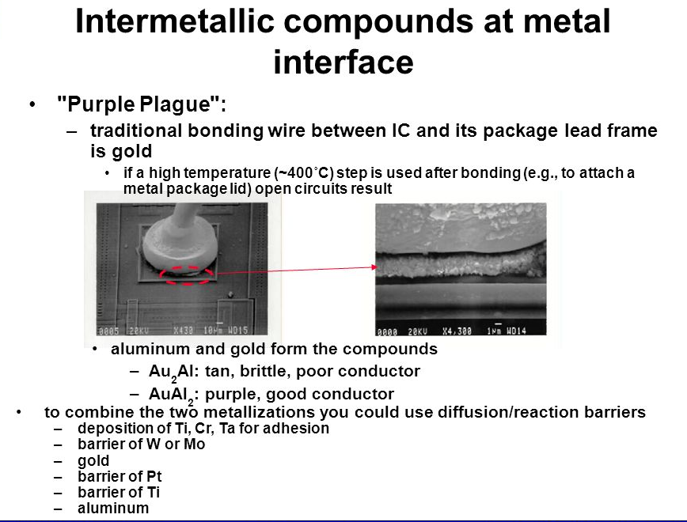

Slide 5
Electromigration
Electromigration is the transport of material caused by the gradual movement of the ions in a conductor due to the momentum transfer between conducting electrons and diffusing metal atoms. The effect is important in applications where high direct current densities are used, such as in microelectronics and related structures. As the structure size in electronics such as integrated circuits (ICs) decreases, the practical significance of this effect increases.
Electromigration decreases the reliability of chips (integrated circuits). It can cause the eventual loss of connections or failure of a circuit.

Slide 6
Although electromigration damage ultimately results in failure of the affected IC, the first symptoms are intermittent glitches, and are quite challenging to diagnose. As some interconnects fail before others, the circuit exhibits seemingly random errors, which may be indistinguishable from other failure mechanisms.
With increasing miniaturization, the probability of failure due to electromigration increases in VLSI and ULSI circuits because both the power density and the current density increase.
Copper has replaced aluminium as the interconnect material of choice. Despite its greater fragility in the fabrication process, copper is preferred for its superior conductivity. It is also intrinsically less susceptible to electromigration.

Slide 7
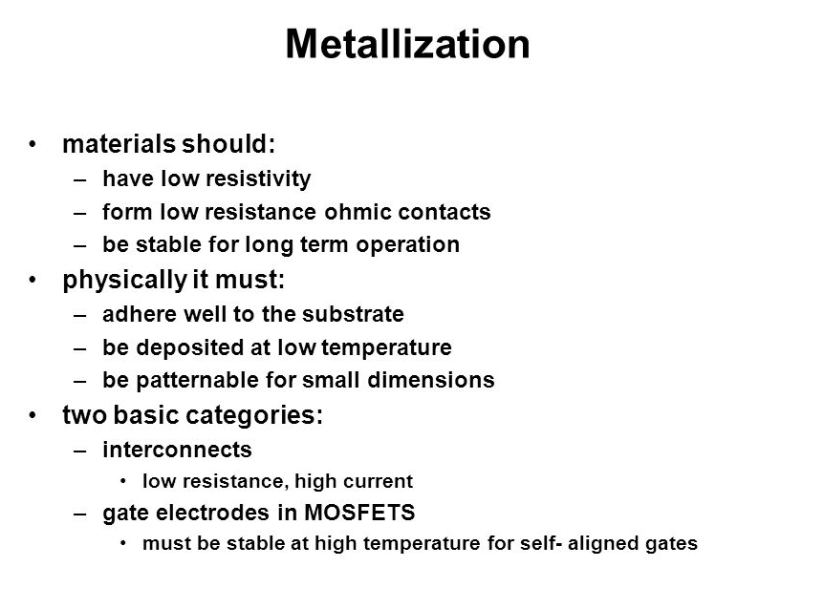

Slide 8
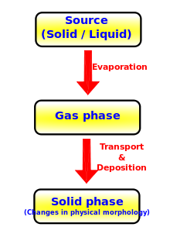
Metallization Process
Chemical Vapour deposition (CVD)
Physical Vapour deposition (PVD)
Evaporation
Sputtering

Slide 9
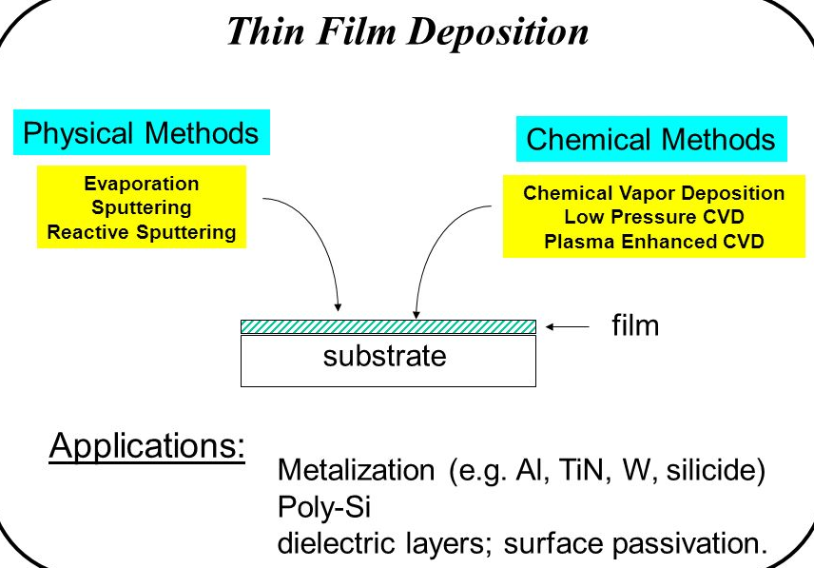
Deposition Methods

Slide 10
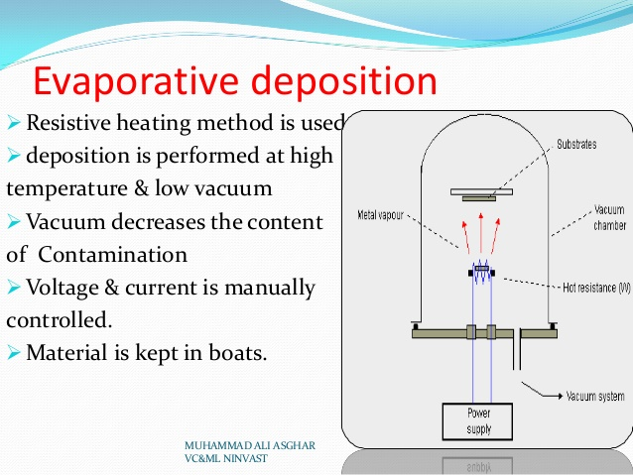

Slide 11
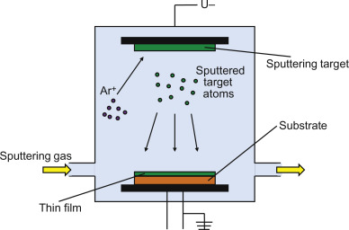
Sputtering

Slide 12
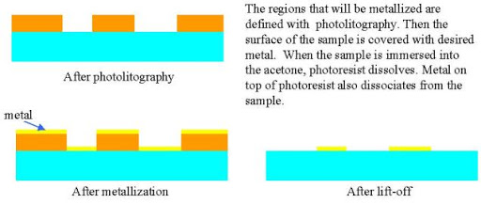
Metallization Patterning

Slide 13
Questions
What are metallization applications in VLSI?
List out the shortcomings of aluminium for metallization.

